Slide 1
Project Title: Cost savings from procurement of sub-component part instead of whole assembly
Charter Template
Business Case/objectives:
Okoloma gas plant has 7 BOGE instrument air compressors used to provide pneumatic signals for instrumentation in controlling and safeguarding the process. Common failure mode with respect to instrumentation is failure of the system pressure switch (CONDOR SWITCH, BOGE). Severally, the switches go bad as result of failed diaphragm which is a sub-component.
Currently, we have over 10 switches down on failed diaphragm in the workshop.
This project aims at coding the sub-component part and procuring 10pcs to use in the revamp of 10 pcs BOGE pressure switch against outright procurement whole assembly.
Expected cost savings for this initiative is circa $2,000 when we procure 10pcs diaphragm @$207.02 from a vendor quotation against outright procurement of pressure switch with material no: 1001234921 - SWITCH,PRESSURE,CONDOR,213147,8bar @$470.02
Potential Benefits & Measurement:
Cost savings of 2k in coding of sub component (BOM)
Asset availability and reduction in downtime of equipment associated with switch failure
Recycling of re-usable switches
Project Scope/Actions :
Obtain material details and code material no for SAP
Secure BFM approval and follow up PO creation
Delivery of materials
Revamp of 10nos pressure switches
Critical Success Factors:
C&P procurement processes
High-level Timeline:
L0-L1: 30 July 2018
L2: 6 August 2018
L3: 30 August 2018
L4: 15 September2018
L5: 20 September 2018
Initiative End
Team members:
Obioha Obinna
Gelor Agberhia

Slide 2
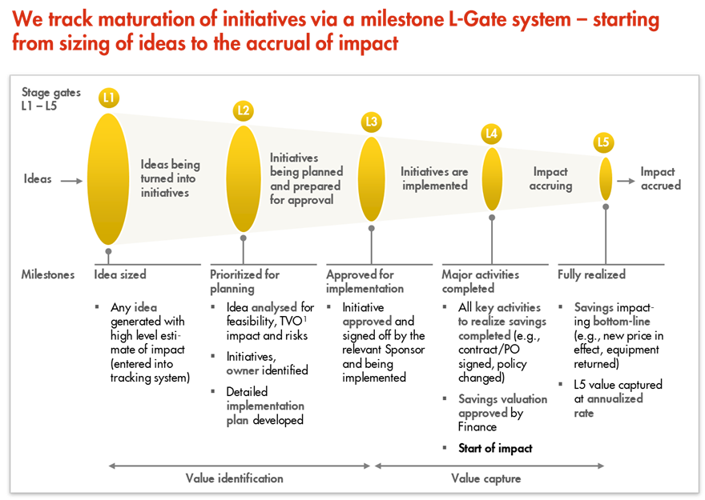
L1 – L5 Gates

